Slide 1
Anesthesia consideration for spinal cord injury
By:- Wubayehu Amare ( BSC,MSC)

Slide 2
Quiz exam
1. Explain the difference between primary and secondary cause of trauma?
2. What Makes Trauma Cases Different from Elective Cases for Anesthesia Professionals?
3. Discuss the Sequential component of trauma evaluation and their difference?
4. List types of hemorrhage during TBI and their definition?
5. Explain the mechanism of increased intracranial pressure, its complication and management?

Slide 3
Out line
Introduction to spinal cord injury
Types and level of injury
Autonomic dysreflexia ,and its anaesthesia consideration
Anaesthesia consideration and management
Special consideration

Slide 4
INTRODUCTION
A spinal cord injury (SCI) is a complex and often life-altering condition resulting from damage to the spinal cord, typically caused by trauma or disease.
The spinal cord, a crucial part of the central nervous system, facilitates the transmission of messages between the brain and the body.
Spinal cord lesions may lead to permanent disability, significant morbidity, and even mortality.

Slide 5
Definition:
SCI: is a condition resulting from damage to the spinal cord, leading to a loss of motor, sensory, and autonomic function below the level of injury.
High spinal injuries often impair cardiorespiratory function, requiring emergent interventions.
The clinical presentation and severity of SCI depend on the level of the spinal cord involved and the nature of the injury

Slide 6
Epidemiology of SCI
Incidence: Approximately 12,000 new SCI cases per year in the United States.
Common Causes:
Trauma: Motor vehicle accidents (MVA), falls, sports injuries, and violence (e.g., gunshot wounds).
Non-traumatic: Tumors, infections (e.g., abscesses), degenerative diseases (e.g., spinal stenosis), and congenital conditions.
Demographics:
Most common in young adults (18-30 years).
Predominantly male (80-90% of cases).

Slide 7
Mechanisms of Spinal Cord Injury
Trauma (e.g., MVA, fall, sports injury):
Compression: Vertebral fractures or dislocations causing pressure on the spinal cord.
Contusion: Bruising of the spinal cord, leading to disruption of blood flow and cell death.
Laceration: Direct cutting or tearing of spinal cord tissue (e.g., by bone fragments).

Slide 8
Cont..
Non-traumatic causes:
Ischemia: Reduced blood flow due to narrowing of blood vessels or embolism.
Infection or tumor: Can compress or infiltrate the spinal cord.
Degenerative diseases: (e.g., spondylosis, spinal stenosis).

Slide 9
Spinal Cord Anatomy
Structure:
The spinal cord is a cylindrical bundle of nerve fibers that extends from the brainstem (medulla oblongata) to the lumbar vertebrae.
It is housed within the vertebral column and encased by protective layers called meninges (dura mater, arachnoid mater, and pia mater).

Slide 10
Cont..
It is a crucial part of the central nervous system (CNS) and serves as the primary pathway for transmitting neural signals between the brain and the rest of the body.
Location: The spinal cord starts at the base of the brain (at the level of the foramen magnum) and extends down to the lumbar region of the vertebral column.
Length: In an average adult, the spinal cord is around 45 cm (18 inches) long.

Slide 11
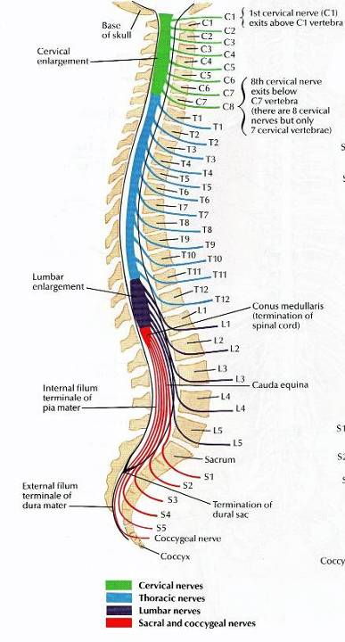
cont..
Organization:
Segments: It's divided into segments
corresponding to the vertebrae in the spinal column.
8 Cervical (C1-C8)
12 Thoracic (T1-T12)
5 Lumbar (L1-L5)
5 Sacral (S1-S5)
1 Coccygeal (Co)

Slide 12
Cont..
Function:
Serves as a communication pathway between the brain and the rest of the body.
Transmits sensory signals (e.g., pain, touch, temperature) from the body to the brain, and motor signals from the brain to control voluntary muscle movement.

Slide 13
Cont…
Nerve Roots: At each segment of the spinal cord, nerve roots branch out from the sides in pairs:
Dorsal (posterior) roots carry sensory information to the spinal cord,
Ventral (anterior) roots transmit motor signals from the spinal cord to the muscles.
Dorsal and ventral roots join at intervertebral foramen to form the spinal nerve

Slide 14
Cont..
Ascending and Descending Tracts: Within the white matter, there are bundles of nerve fibers known as tracts.
Ascending tracts carry sensory information towards the brain,
Descending tracts carry motor commands from the brain to the body.

Slide 15
Cont…
Ascending Tracts (Sensory Pathways):
Spinothalamic Tract: Transmits pain, temperature, and crude touch sensations.
Dorsal Column (posterior) Pathway: Carries fine touch, proprioception (sense of body position), pressure, and vibration sensations.
Spinocerebellar Tracts: Transmit proprioceptive information to the cerebellum, aiding in coordination and balance.
Spinoreticular Tract: Involved in transmitting pain signals to the reticular formation, which is associated with arousal and attention.

Slide 16
Cont…
Descending Tracts (Motor Pathways):
Corticospinal Tract (Pyramidal Tract): Responsible for voluntary movement; carries motor commands from the cerebral cortex to the spinal cord.
Rubrospinal Tract: Facilitates motor function and muscle tone.
Reticulospinal Tracts: Control various involuntary movements and posture.
Tectospinal Tract: Involved in reflexive head and neck movements in response to visual and auditory stimuli.
Vestibulospinal Tracts: Contribute to balance, posture, and control of eye movements, receiving input from the inner ear's vestibular system.

Slide 17
Posterior column and lateral corticospinal tract crosses over at medulla oblongata
Spinothalamic tract crosses in the spinal cord and ascends on the opposite side
NB to understand this as it helps to understand the clinical features of injury patterns and the neurological deficit

Slide 18
Corticospinal Tract (CST)
Function:
primary motor pathway that facilitates voluntary movement, especially skilled movements of the limbs (e.g., hand and finger movements).
Pathway:
Origination: The CST originates from the primary motor cortex in the frontal lobe of the brain.

Slide 19
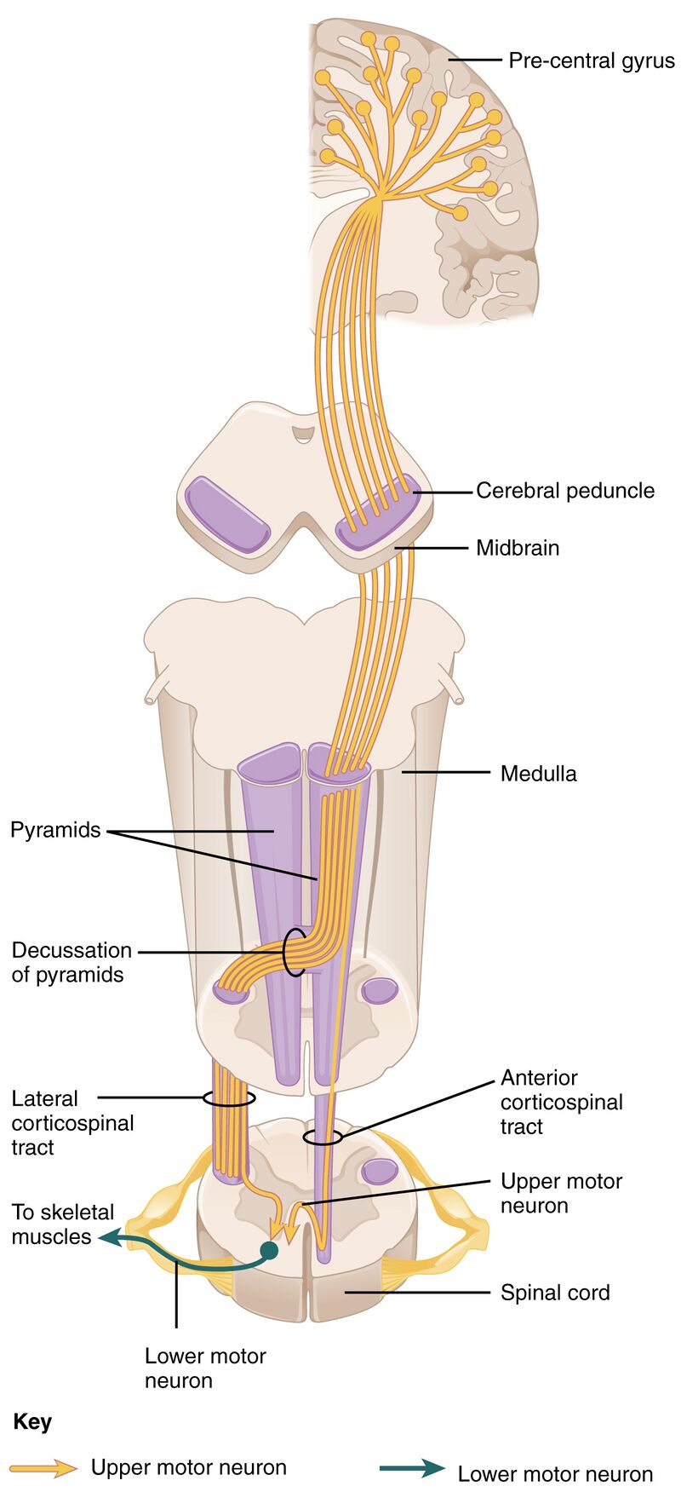
Descent:
The fibers travel through the internal capsule, descending through the brainstem (midbrain, pons, and medulla).
90% decussate at the medullary pyramids, forming the lateral corticospinal tract (LCST). control the muscles of the contralateral side of the body
The 10% ventral corticospinal tract (VCST) remains uncrossed and controls the ipsilateral side at the level of the spinal cord, but these fibers are only present in the upper spinal cord (cervical and upper thoracic).

Slide 20
Cont..
Clinical Relevance:
Damage to the LCST (e.g., from a stroke or spinal cord injury) can lead to contralateral paralysis or weakness of the muscles.

Slide 21
Spinothalamic Tract (STT)
Function:
The STT is responsible for relaying pain, temperature, and crude touch sensations from the body to the brain.
Pathway:
Origination: Sensory neurons in the dorsal root ganglia pick up stimuli from the skin, joints, and muscles.
The fibers enter the spinal cord and synapse in the dorsal horn.

Slide 22
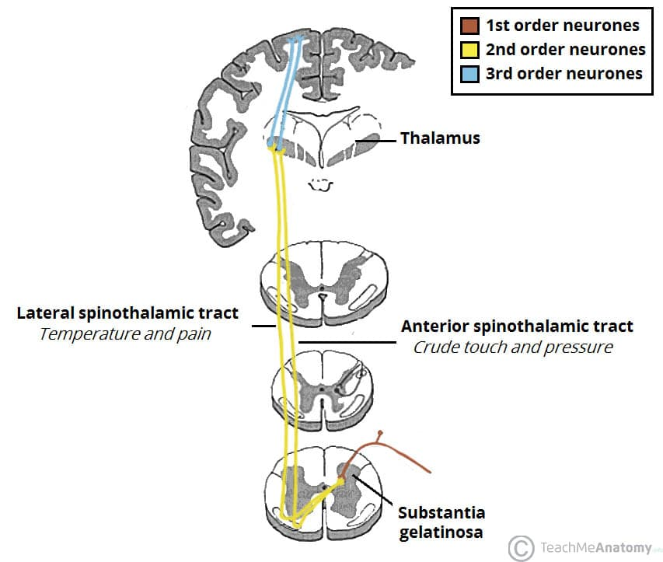
Cont..
The second-order neurons cross (decussate) at the spinal cord level and ascend in the anterolateral columns of the spinal cord.
The tract terminates in the thalamus, and third-order neurons project to the somatosensory cortex in the parietal lobe
Clinical Relevance:
Damage to the STT (e.g., from a spinal cord injury) results in loss of pain and temperature sensation on the contralateral side below the level of the injury.

Slide 23
Dorsal Columns (DC)
Function:
The DC carries proprioception, fine touch, pressure, and vibration sensations to the brain.
These sensations are important for body awareness, coordination, and sensory perception.
Pathway:
The first-order neurons ascend ipsilaterally (on the same side) in the dorsal columns.

Slide 24
Cont..
Second-order neurons then decussate at the medulla, ascend as the medial lemniscus, and synapse in the thalamus, where the third-order neurons project to the somatosensory cortex.
Clinical Relevance:
Damage to the dorsal columns (e.g., in tabes dorsalis or posterior cord syndrome) results in loss of proprioception and fine touch on the ipsilateral side below the level of the injury.

Slide 25
Blood supply to spinal cord
The blood supply to the spinal cord is essential for its proper function and nourishment.
The spinal cord receives its blood supply from several arteries that run along its length, providing oxygen and nutrients to its tissues.
There are two primary sources of blood flow to the spinal cord:

Slide 26
Cont…
Anterior Spinal Artery
Origin: Vertebral arteries (or aorta)
Supplies: Anterior two-thirds of the spinal cord
Path: Runs along the anterior surface of the spinal cord
Posterior Spinal Arteries
Origin: Vertebral arteries (or segmental arteries from aorta)
Supplies: Posterior one-third of the spinal cord
Path: Runs along the posterior surface of the spinal cord
Number: Multiple and smaller in size

Slide 27
Cont…
Segmental Medullary Arteries
Sources: Vertebral, ascending cervical, intercostal, and lumbar arteries
Function: Penetrate the spinal cord at various levels, supplying specific spinal segments
Importance: Contribute to overall vascular network of the spinal cord
Collateral Circulation
If one artery is compromised, collateral circulation helps mitigate damage and maintain function

Slide 28
Cont..
Clinical Relevance
Ischemia Risk: Interruption in blood supply (injury, compression, vascular conditions) can lead to spinal cord ischemia
Consequence: Damage to neural tissues, potential neurological deficits or paralysis

Slide 29
Levels of Spinal Cord Injury
Cervical Injuries (C1-C8):
Impact: Paralysis (quadriplegia), loss of sensation, respiratory problems.
Higher Injuries (C1-C4): Require ventilator support.
Lower Injuries (C5-C8): May have limited arm function.
Thoracic Injuries (T1-T12):
Impact: Paralysis of lower limbs (paraplegia), potential loss of trunk control.

Slide 30
Cont..
T1-T6: Full trunk and abdominal control may be impaired.
T7-T12: Improved trunk control but limited leg function.
Lumbar/Sacral Injuries (L1-S5):
Impact: Partial paralysis or weakness in legs, possible bladder/bowel dysfunction.
L1-L5: Some motor function in legs, difficulty walking.
S1-S5: Potential for partial recovery of leg function, especially if injury is closer to sacral region.

Slide 31
Types of Spinal Cord Injury
Complete SCI:
Total loss of sensory and motor function below the level of injury.
No preserved function in the affected segments.
Incomplete SCI:
Some degree of sensory or motor function remains below the level of injury.

Slide 32
1. Central Cord Syndrome (CCS)
Pathophysiology:
Injury primarily affects the central portion of the spinal cord (especially the cervical region) due to hyperextension or compression.
Common in elderly individuals with degenerative spinal conditions.
Clinical Features:
Motor deficits: Upper extremities more affected than lower extremities (distal > proximal weakness).

Slide 33
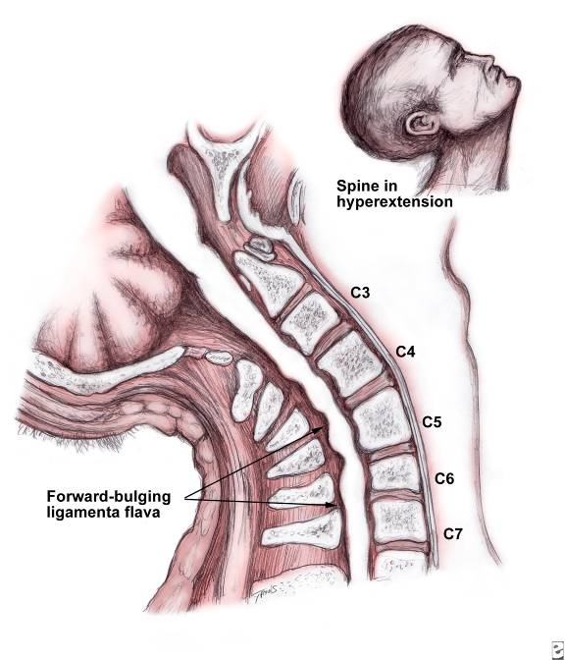
Cont..
Sensory loss: Loss of pain and temperature sensation (due to damage of spinothalamic tracts).
Preserved: Proprioception and light touch, often intact in the lower extremities.
Cause:
Typically caused by cervical spondylosis, hyperextension injuries, or anterior spinal artery syndrome.

Slide 34
2. Anterior Cord Syndrome (ACS)
Pathophysiology:
Injury to the anterior part of the spinal cord, often from damage to the anterior spinal artery.
Can also result from flexion injuries, vertebral fractures, or disk herniations.
Clinical Features:
Motor deficits: Complete paralysis below the level of injury (due to corticospinal tract damage).

Slide 35
Cont..
Sensory loss: Loss of pain and temperature sensation below the level of injury (spinothalamic tract involvement).
Preserved: Proprioception, vibration sense, and light touch (due to intact posterior columns).
Cause:
Disruption of the anterior spinal artery, leading to ischemia in the anterior cord.

Slide 36
3. Brown-Séquard Syndrome (Lateral Hemicord Syndrome)
Pathophysiology:
Hemisection of the spinal cord due to trauma or tumors.
Affects one half of the spinal cord, typically from a penetrating injury (e.g., stabbing or gunshot wound).
Clinical Features:
Ipsilateral (same side) motor weakness or paralysis: Due to corticospinal tract damage.

Slide 37
Cont..
Ipsilateral loss of proprioception and vibration: Due to damage to the dorsal column.
Contralateral (opposite side) loss of pain and temperature: Due to damage to the spinothalamic tract (which crosses over to the opposite side of the spinal cord shortly after entering).
Cause:
Often caused by trauma (e.g., stabbing, gunshot), tumors, or multiple sclerosis.

Slide 38
4. Posterior Cord Syndrome (Dorsal Column Syndrome)
Pathophysiology:
Damage to the posterior columns (dorsal columns) of the spinal cord, often due to vascular events or tumors.
Typically results from injury to the posterior spinal arteries or compression of the cord from a mass lesion.
Clinical Features:
Loss of proprioception, vibration sense, and light touch below the level of injury (due to posterior column involvement).

Slide 39
Cont..
Motor function: Often preserved, as the corticospinal tract is unaffected.
Pain and temperature sensation usually preserved.
Cause:
Ischemia, tumors, or trauma affecting the posterior cord.

Slide 40
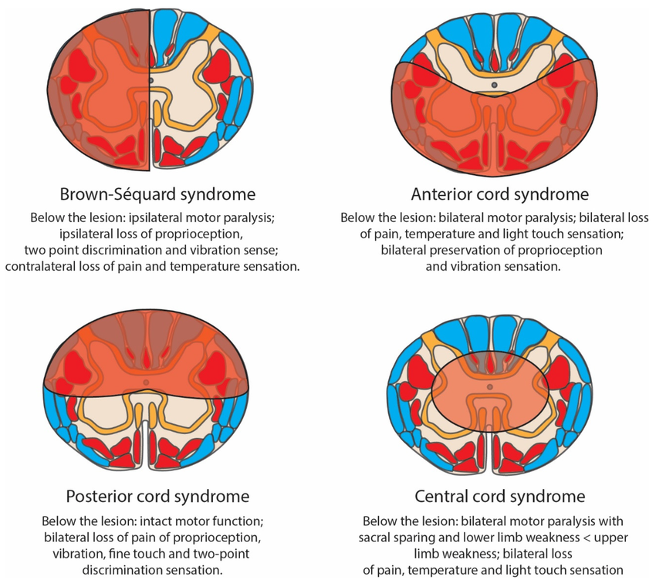

Slide 41
6. Cauda Equina Syndrome
Pathophysiology:
Injury to the nerve roots below the conus medullaris (the cauda equina), affecting the lower lumbar and sacral spinal roots.
Caused by herniated discs, spinal tumors, or trauma.
Clinical Features:
Severe lower back pain.
Saddle anesthesia: Loss of sensation in the buttocks, genitalia, and inner thighs.

Slide 42
Cont..
Bilateral leg weakness or paralysis (often asymmetric).
Bladder and bowel dysfunction (urinary retention, incontinence).
Sexual dysfunction.
Absent or diminished reflexes in the lower extremities.
Cause:
Compression of the cauda equina nerve roots, requiring urgent surgical intervention.

Slide 43
7. Spinal Shock
Pathophysiology:
A temporary loss of all spinal cord activity below the level of injury, occurring immediately after SCI.
The injury results in a reflex arc disruption, and the spinal cord becomes atonic and reflexes are lost.
Clinical Features:
Flaccid paralysis below the level of injury.
Loss of reflexes, including the bulbocavernosus reflex.

Slide 44
Cont..
Hypotension and bradycardia due to loss of sympathetic tone.
Areflexia: No voluntary movement or sensation.
Cause:
Acute SCI; resolves over days to weeks as spinal cord activity gradually returns.

Slide 45
Pathophysiology of Spinal Cord Injury
Spinal Cord Injuries (SCIs) arise from complex mechanisms that lead to varying degrees of neurologic deficits, depending on the injury's location and severity.
These mechanisms are classified into :
Primary and
Secondary injuries

Slide 46
Primary Injury
The primary injury occurs at the moment of the traumatic event and results from direct mechanical forces that damage the spinal cord.
The common mechanisms include:
Direct Cord Trauma: The most frequent primary SCI mechanism, often resulting from an impact or compression.
Persistent Compression: Injuries that occur from prolonged pressure on the spinal cord, caused by space-occupying lesions such as:
Vertebral fractures, Malignancies, Hematomas, Abscesses

Slide 47
Cont..
Hyperextension Injuries: These injuries typically result from transient compression, rather than impact alone.
typically whiplash or sports-related injuries
Can cause soft tissue strain, ligament damage, and minor cord injury
Distraction Injuries
Axial stretching of the spinal cord

Slide 48
Cont..
Results from forces pulling apart two adjacent vertebrae
Can lead to nerve root damage and spinal cord tearing
Lacerations/Transection
Direct cuts through the spinal cord by:
Sharp bone fragments
Severe dislocations
Penetrating objects (e.g., bullets, knives)
Can lead to complete severance of the cord

Slide 49
Secondary Injury
Vascular Damage:
Disrupted blood flow → ischemia → additional damage
Ionic Imbalances:
Sodium, calcium, potassium imbalance → neuronal dysfunction, cell death
Free Radical Formation:
ROS generated → oxidative stress → further tissue injury
Inflammatory Response:
Microglial activation, cytokine release → tissue damage, swelling
Neurotransmitter Accumulation (Excitotoxicity):
Excessive glutamate release → overstimulation → neuronal death

Slide 50
Autonomic Dysreflexia
Autonomic Dysreflexia (AD) is a potentially life-threatening condition that occurs in individuals with spinal cord injuries (SCI), especially those with lesions above the T6 level.
It is characterized by a profound autonomic response to stimuli below the level of the spinal injury.
Clinical Manifestations of Autonomic Dysreflexia
Sudden increase in blood pressure: A rise of at least 20 mmHg from baseline.

Slide 51
Cont..
Baroreflex-mediated bradycardia: A decrease in heart rate as a response to the increased blood pressure.
Symptoms may include:
Severe headache
Flushing
Sweating
Chills
Nasal congestion
Piloerection (goosebumps)
Pallor
Notes:
Piloerection – is the contraction of small muscles at the base of hair follicles resulting in visible erection of hair

Slide 52
Cont..
Severe manifestations: If left untreated, AD can lead to:
Intracranial complications such as increased intracranial pressure, seizures, and intracranial hemorrhage.
Cardiac issues like myocardial ischemia, arrhythmias, and pulmonary edema.
Life-threatening complications such as stroke or death.

Slide 53
Incidence and Risk Factors
Incidence: Between 50% and 70% in SCI patients with lesions above T6.
The incidence increases with:
Higher-level lesions (above T6).
Complete spinal cord lesions.
Severity: The higher the lesion level, the more severe the symptoms of AD.

Slide 54
Pathophysiology of Autonomic Dysreflexia
AD is believed to result from a disordered sympathetic response to stimuli below the level of the spinal cord injury:
Loss of supraspinal inhibitory control: Damage to the spinal cord above the level of injury leads to loss of inhibitory signals from the brain that normally regulate sympathetic nervous system responses.
Exaggerated sympathetic activation: The spinal cord becomes hyper-reactive, with the sympathetic preganglionic neurons below the injury site discharging excessively in response to stimuli.

Slide 55
Cont..
Sympathetic overactivity: This can cause significant increases in:
Vasomotor activity (leading to hypertension).
Pilomotor activity (leading to piloerection).
Sudomotor activity (leading to sweating).
These activities are often seen as exaggerated responses to what would otherwise be normal stimuli.

Slide 56
Cont..
Effect of T6 Lesion Level:
When the spinal injury is above T6, it activates splanchnic vasculature, which can lead to severe hypertension and compensatory bradycardia.
Effect of Lesions Below T6:
In SCI patients with lesions below T6, the sympathetic control of splanchnic vasculature remains intact, which typically prevents AD from occurring

Slide 57
Triggers of Autonomic Dysreflexia
AD is usually triggered by noxious stimuli below the level of the injury, particularly in the abdominal and pelvic regions.
Common triggers include:
Bladder distension (80% of cases): Often from urinary retention or catheter blockage.
Acute abdominal issues: Including bowel distension or obstruction.
Urinary tract infections (UTIs).

Slide 58
Skeletal fractures or pain.
Pressure ulcers (skin breakdown).
Sexual activity or uterine contractions.
Even gentle skin stimulation, like friction from bedding or clothing.

Slide 59
Anesthetic Considerations in SCI Patients
Pre-Operative Assessment: History Review:
Level of injury: Affects airway management (e.g., cervical injury may limit neck movement).
Time since injury: Succinylcholine contraindicated within 3 days to 9 months due to hyperkalaemia risk.
Sensory level: Helps determine if local anaesthesia is sufficient for minor procedures below the level of injury.

Slide 60
Cont..
Physical Exam:
Airway Assessment: Check dental status, Mallampati score, mouth opening, neck mobility. SCI patients may have limited neck mobility.
Respiratory and Cardiovascular Status: Assess baseline vital capacity, blood pressure, and heart rate.

Slide 61
Access and Monitoring
Standard Monitors: Temperature probe, ECG, pulse oximetry, blood pressure cuff, capnography.
Large bore IVs or central venous catheters for potential hemodynamic instability.
Emergency Equipment: Suction device, ventilator, anesthesia machine, oxygen, emergency medications (e.g., atropine, epinephrine).
Pre-oxygenation: Critical to ensure adequate oxygenation before intubation.

Slide 62
Induction and Intubation
Induction Drugs:
Common agents: Propofol, ketamine, etomidate (often with opioids and lidocaine).
SCI patients may have reduced blood volume and muscle mass due to deconditioning, increasing sensitivity to anaesthetics agents and risk of hypotension.
Renal Dysfunction: SCI patients at higher risk, and many induction agents are cleared renally, necessitating reduced dosages.

Slide 63
Cont..
Neuromuscular Blocking Agents:
Succinylcholine: Contraindicated 3 days to 9 months post-injury due to risk of hyperkalemia.
NDMR can be safely used but may act slower.
Airway Management:
High-level injuries (Cervical/High Thoracic): Manual in-line stabilization or awake fiberoptic intubation may be needed to prevent further spinal injury.

Slide 64
Cont..
Intubation Response Variability:
Cervical lesions: Dampened pressor response (minimal increase in systolic pressure, heart rate).
Thoracic lesions: ↑HR and norepinephrine release.
Low thoracic lesions: Similar to control group with marked catecholamine

Slide 65
Intraoperative Care
Anesthesia Types:
Both TIVA and inhalation agents are safe options.
Propofol and sevoflurane commonly used.
Hemodynamic Considerations:
Hypotension: Can occur with propofol or sevoflurane;
critical to maintain MAP 85-90 mmHg during the first 7 days post-injury to optimize spinal cord perfusion.
Vasopressors: Use when hypotension persists.

Slide 66
Cont..
Autonomic Dysreflexia (Hyperreflexia):
Signs in awake patients: Headache, sweating.
In anesthetized patients: May present as hypertension or bradycardia.
Treatment: Deepen anaesthetic, administer antihypertensive medications (e.g., hydralazine, nitroprusside), or IV lidocaine.
Dexmedetomidine:
Used to prevent autonomic dysreflexia. Case reports suggest its efficacy in SCI patients during surgery with no dysreflexia episodes.

Slide 67
Cont..
Regional Anaesthesia:
Spinal anaesthesia may prevent autonomic dysreflexia in urological procedures.
Epidural anaesthesia: Suitable for abdominal surgeries and pregnant SCI patients.
Nerve blocks: Effective for upper extremity surgeries (e.g., brachial plexus block).

Slide 68
Postoperative Care
Pain Management:
Chronic pain is common in SCI patients, with neuropathic and nociceptive pain categories.
Multimodal Approach:
Acetaminophen, NSAIDs, opioids, topical analgesics.
Regional nerve blocks and physical rehabilitation.
Coordination with interventional pain management team for optimal care.

Slide 69
Special consideration
Obstetric SCI Patients:
Autonomic Dysreflexia is a major concern.
Pre-pregnancy evaluation with multidisciplinary team.
Epidural or combined spinal-epidural anesthesia recommended to block noxious stimuli.
If dysreflexia occurs, treatment involves repositioning, relieving stimuli, and antihypertensive medications (e.g., nifedipine, labetalol).

Slide 70
Cont..
Paediatric SCI Patients:
Stricter NPO guidelines to prevent aspiration due to delayed gastric emptying.
Midazolam may exacerbate hypotension, so used with caution.
Calming presence in OR critical

Slide 71
Cont..
Chronic Pain Management:
Many SCI patients suffer from chronic neuropathic pain.
Multimodal pain management, including pharmacologic agents (e.g., gabapentinoids, anticonvulsants) and non-pharmacologic therapies (e.g., nerve blocks), is often necessary.

Slide 72
Reference
1.Paul G Barash: Handbook of Clinical Anesthesia (8th edition). Lippincott Williams & Wilkins publications, Inc., 2016.
2.Robert K Stoelting: Stoelting’s anesthesia and co-existing disease (5th edition). Churchill Livingstone, an Imprint of Elsevier, 2002.
3.Alan R Aitkenhead: Textbook of Anaesthesia (6th edition). Churchill Livingstone publication, an Imprint of Elsevier, 2001.
4.G. Edward Morgan: Clinical Anesthesiology (6th edition). McGraw-Hill Companies, Inc. 2006

